Slide 1
Let’s build a knowledgeable chatbot with Microsoft Bot Framework, Azure Bot Services, and QnA Maker

Slide 2
QnA Maker
QnA Maker is a cloud-based Natural Language Processing (NLP) service that easily creates a natural conversational layer over your data.
Allows to create custom knowledge base with questions and answers from multiple types of documents to provide accessibility to static information.
Support for multiple languages
Chit-chat feature – multiple pre-build Q&A with different attitudes (friendly, witty, etc..)
Easily create multi-turn Dialogs

Slide 3
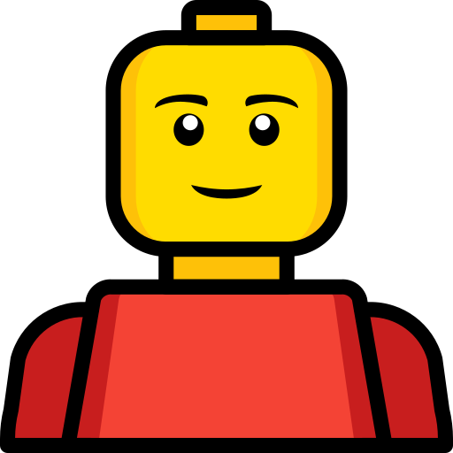
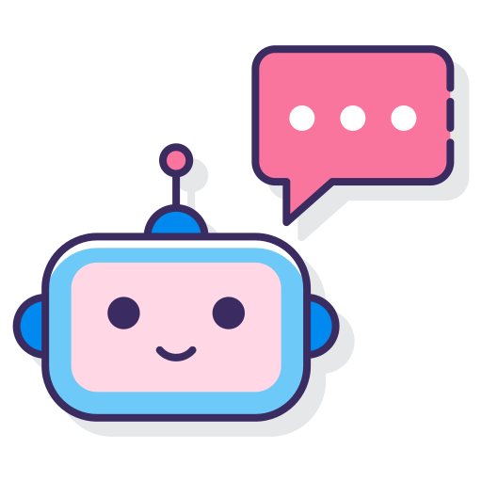
QnA Maker
What’s the WiFi password?
The WiFi network is AZURE and the password is AKASkyNet.

Slide 4





QnA Maker
What’s the WiFi password?
What’s the wifi?
How do I connect to the Wi Fi?
How do I get on the wifi?
How to get on the wireless?

Slide 5
What’s the WiFi password?
What’s the wifi?
How do I connect to the Wi Fi?
How do I get on the wifi?
How to get on the wireless?
Questions
The WiFi network is AZURE and the password is MSIGNITE.
Answer

Slide 6
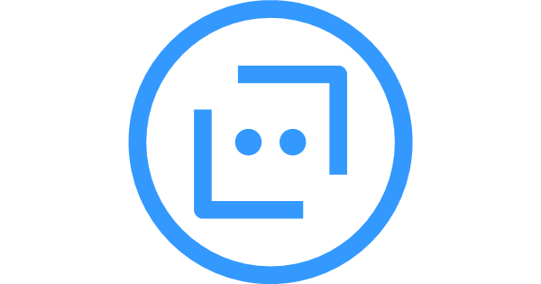
Azure Bot Framework

Slide 7


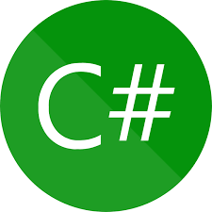
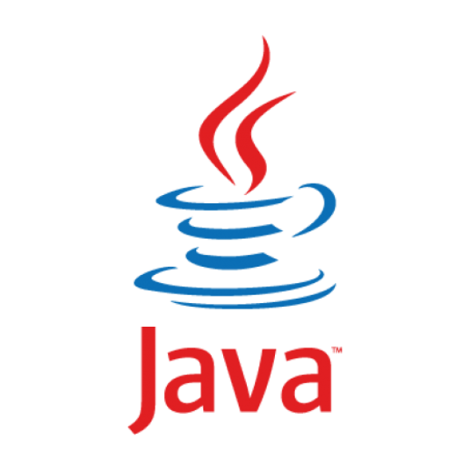
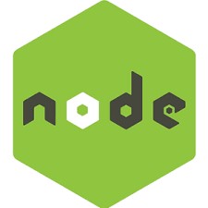
Comprehensive framework
Building enterprise-grade chatbots
Notes:
Choose any language for quick start

Slide 8
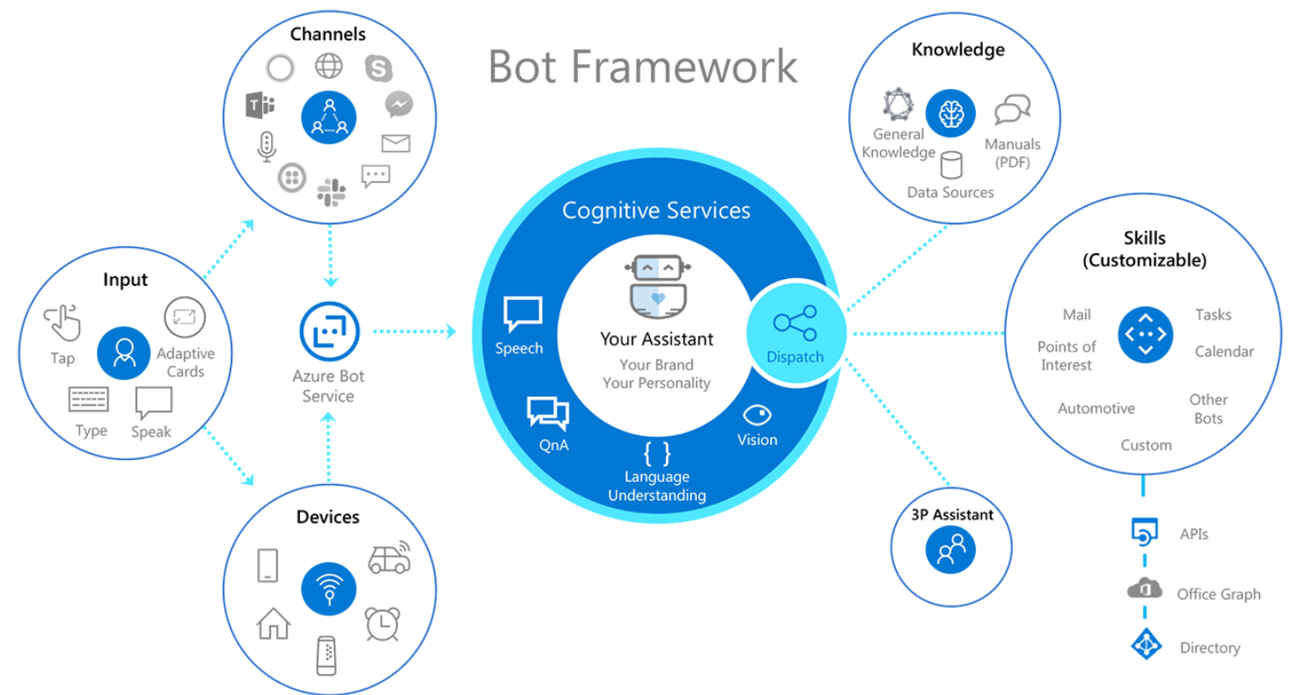
Notes:
Choose any language for quick start

Slide 9
Activities - Events
An activity initiated by a user and the bot’s matching activities to it are defined as a turn.
Activities are sent from a user to a bot and vice versa.
When Bot service identifies an activity from the user it sends an HTTP request to the bot it is linked to and starts a new turn In a conversation.
Type of activities are: message, conversation update, custom events, etc..
Bot has the possibility to send more elaborate activities such as: prompts, cards, animations and more.

Slide 10

Context - State
Conversation State and User State are managed by a storage.
Storage can be in-memory (usually used for development) or using an external storage for Example Blob Storage. Usage of custom Storage can also be implemented.
Conversation state allows to continue a conversation from its last stop.
User State allows to store data about user (gathered during a conversation or before it started) in order to make meaningful conversations.
Both states can be obtained using a context object which is being sent in each user activity and is also used for each bot activity.

Slide 11
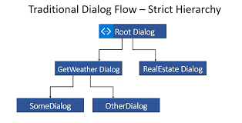
Dialogs
A dialog is compound from one or more steps.
A step is basically a function that is invoked according to the stage inside a dialog.
From a dialog (or more precisely from a step inside a dialog) a bot can start a new Dialog (Nested Dialog), replace the dialog (end current dialog and start a new one), end the dialog, cancel all dialogs or continue to the next step.
All the possible dialogs of a bot are stored in an array (DialogSet) and each dialog has its own unique name.

Slide 12

Dialog stack
Each Conversation as its own dialog stack.
The dialog stack can have zero (empty stack) or multiple dialogs.
When a dialog ends it is “popped” out of the stack and the dialog that began this dialog is now invoked.

Slide 13




Conversation Statuses
A conversation can be in any given time in one of following statuses:
Empty: means that currently its dialog’s stack is empty.
Waiting: means that currently an active dialog takes place.
Cancelled: means that a bot cancelled all conversations in the stack from a certain dialog.
Complete: means that certain dialog was completed.
Bot can utilize the conversation status with the user state to make different actions.

Slide 14
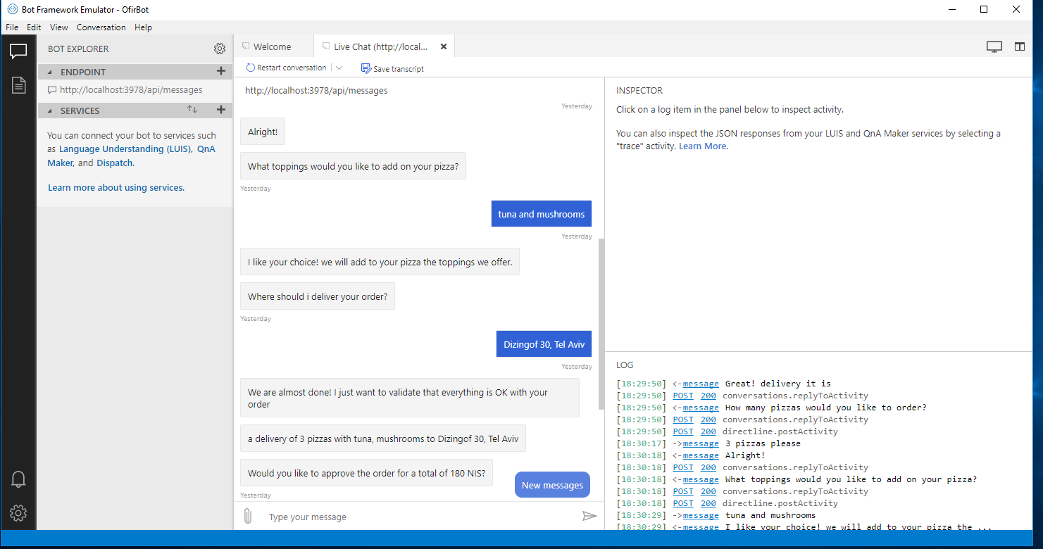
Bot Framework Emulator
The Bot Framework Emulator is a desktop application that allows bot developers to test and debug bots built using the Bot Framework SDK.

Slide 15
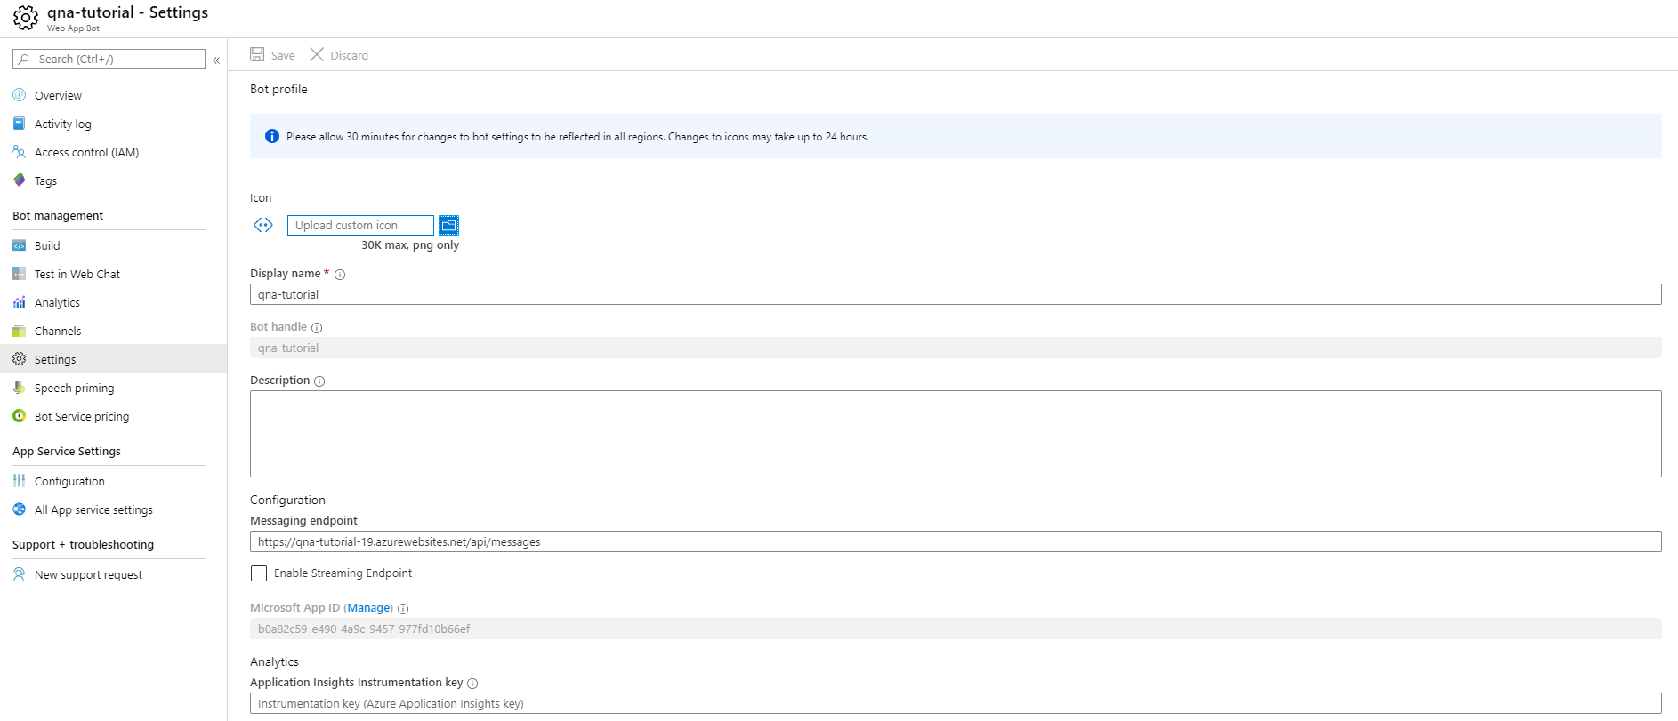
Bot Service settings
Settings contain valuable information about the created bot resource:
Icon – how will the new bot will be shown In certain media channels.
Display name – The name of the bot in all channels
Messaging endpoint – where to send http request with user activities.

Slide 16
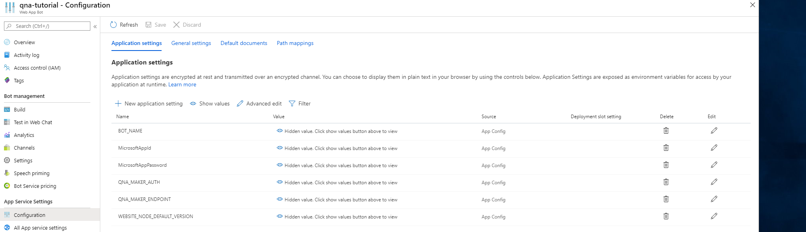
Environment Variables
Environment variables can be added as new application settings from configurations tab. At runtime they will be available to the web service.

Slide 17
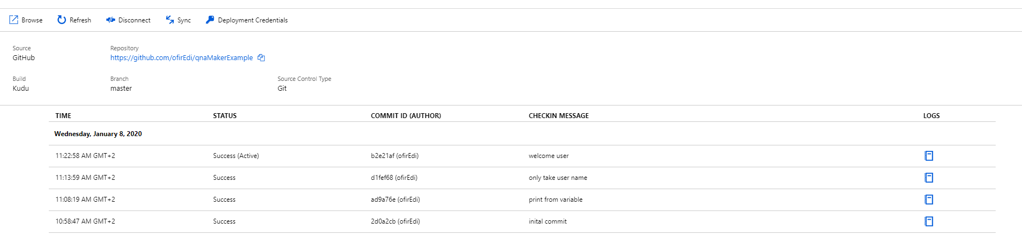
CI / CD
Bot Service provides the ability to easily deploy changes to a bot with zero downtime.
When choosing to automatically publish updates to Azure with continuous deployment when changes detected in a defined branch (usually master) build of the new version will occur following with a deployment.
There are multiple supported repositories such as: GitHub, BitBucketGit, TFS, and many more.
If an error occurs during deployment the older version will stick.
A job log of all builds is maintained by the Bot Service.

Slide 18
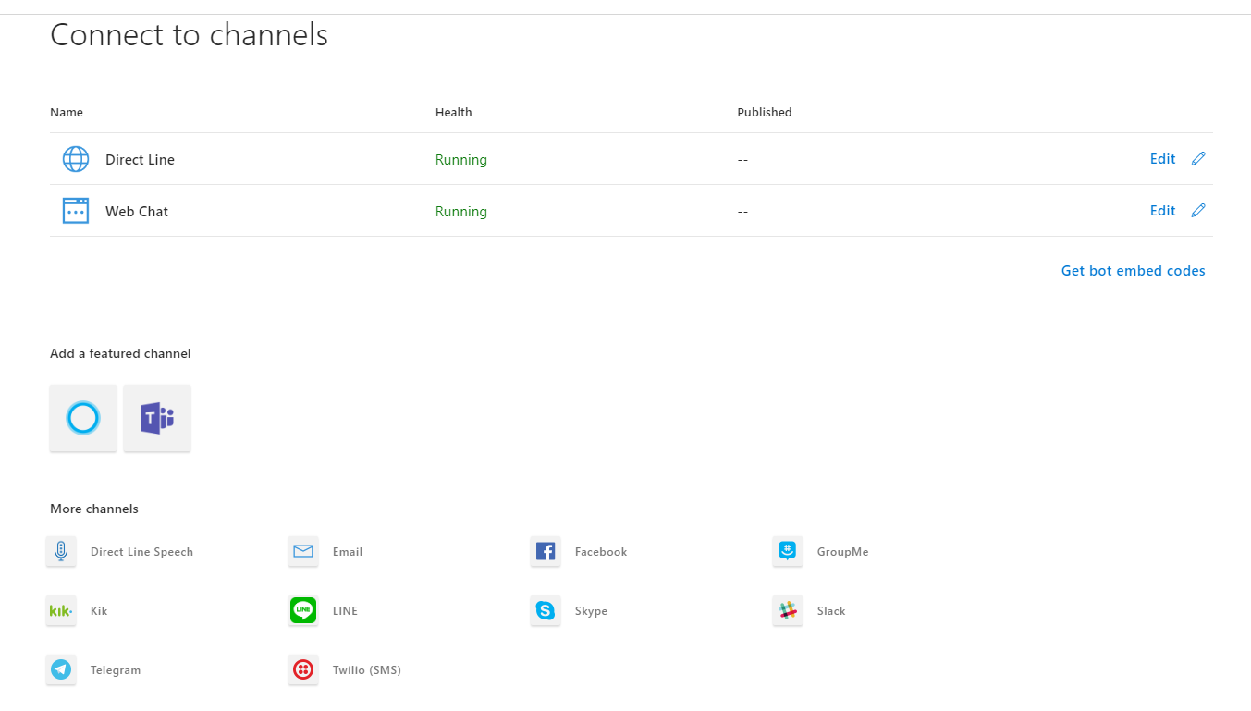
Connect Bot to Channels
In Order to form communication between a Bot Service and a Media Channel, a connector is require.
The connector should send activities from users to bot and vice versa.
Azure Bot Service provides multiple built-in connectors to channels like: WebChat, Microsoft Teams, Microsoft Cortana, Facebook, Slack, Telegram and more.
Any media channel can be connected with bot service using Direct Line.

